Slide 1
vMR: the HL7 virtual Medical Record Standard
May 16, 2013
Health eDecisions All Hands Call
Claude Nanjo
David Shields

Slide 2
Background
A “holy grail” of clinical informatics is scalable, interoperable CDS
Key requirement for interoperable CDS and re-use of CDS knowledge resources = use of a common patient data model
  Referred to as a “Virtual Medical Record” or vMR (Johnson et al., AMIA Annu Symp Proc, 2001)
Lack of a common vMR has been a major barrier to sharing knowledge and scaling CDS
Notes:
SCT 14May

Slide 3
Example Challenge without VMR
Observation Blood Pressure
Code = BP Systolic = 120 mmHg
Value = 120/80 mmHg Diastolic = 80 mmHg
Observation Vital Sign
Code = BP Type = BP
Observation Value = 120/80
Code = SBP Units = mmHg
Value = 120 mmHg
Observation
Code = DBP
Value = 80 mmHg
Notes:
SCT 14May

Slide 4
vMR Goal
Provide common information model upon which interoperable clinical decision support resources (e.g., rules) can be developed

Slide 5
Project History
Analysis of data required by 20 CDS systems from 4 countries (Kawamoto et al., AMIA 2010)
Refinement of vMR via implementation within OpenCDS
Adopted in September 2011 as Informative Specification

Slide 6
Why Not Just Use the CCDA as the vMR?
CCDA does not include all needed information
  E.g., Family history model suitable for CDS
CCDA is not sufficiently intuitive for direct use by CDS knowledge authors
CCDA is deeply nested and verbose, which adds performance penalties in volume production
HOWEVER:
CCDA can be mapped into the vMR, which has a simpler structure that is more conducive to evaluation
Notes:
SCT 14May

Slide 7
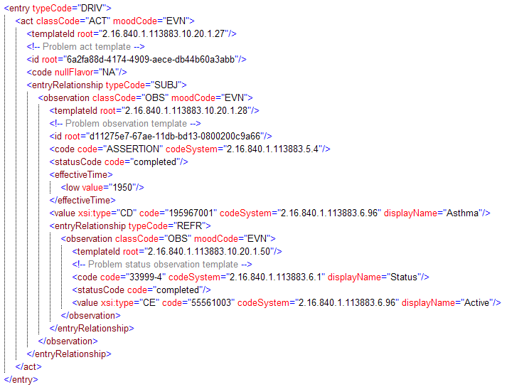
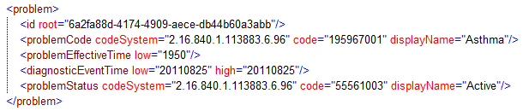
Problem Model – CCD vs. VMR
Notes:
SCT 14May

Slide 8
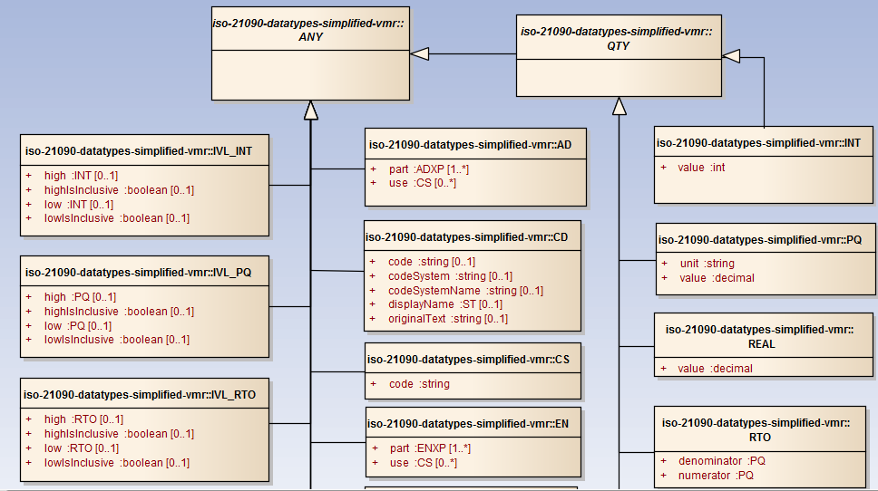
Simplified ISO 21090 Data Types
Notes:
SCT 14May

Slide 9
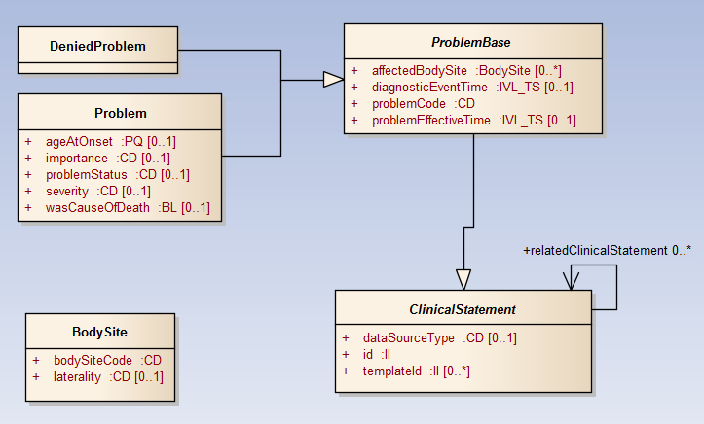
Example Clinical Statement
Notes:
SCT 14May

Slide 10
vMR: decoded payload
<cdsInput>
<templateId root="2.16.840.1.113883.3.1829.11.1.1.1"/>
<vmrInput>
<templateId root="2.16.840.1.113883.3.1829.11.1.2.2"/>
<patient>
<templateId root="2.16.840.1.113883.3.1829.11.2.1.1"/>
<id extension=“1234567890" root="2.16.840.1.113883.3.795.5.2.1.1"/>
<demographics>
<birthTime value="19920713"/>
<gender code="F" codeSystem="2.16.840.1.113883.1.11.1"/>
</demographics>
<clinicalStatements>
<encounterEvents>
<encounterEvent>
<templateId root="2.16.840.1.113883.3.1829.11.4.3.2"/>
<id extension="testVMRoneLowHct" root="2.16.840.1.113883.3.795.5.2"/>
<dataSourceType code="Administrative"
codeSystem="2.16.840.1.113883.3.795.12.2.5.1"/>
<encounterType code="I" codeSystem="2.16.840.1.113883.3.795.12.2.6.1" displayName="Inpatient"/>
<encounterEventTime high="" low="20130301"/>
<relatedClinicalStatement>
<targetRelationshipToSource code="COMP"
codeSystem="2.16.840.1.113883.3.795.12.1.2"/>
<observationResult>
<templateId root="2.16.840.1.113883.3.1829.11.6.3.6"/>
<id extension="test1" root="2.16.840.1.113883.3.795.5.2.3.4"/>
<dataSourceType code="Clinical"
codeSystem="2.16.840.1.113883.3.795.12.2.5.1"/>
<observationFocus code="20570-8" codeSystem="2.16.840.1.113883.6.1"
displayName="Hematocrit"/>
<observationEventTime high="20130329" low="20130329"/>
<observationValue><physicalQuantity unit="%" value="45.7"/>
</observationValue>
</observationResult>

Slide 11
Further Information
vMR:
http://wiki.hl7.org/index.php?title=Virtual_Medical_Record_(vMR)
Notes:
SCT 14May

